Slide 1
Nirinasoa’s Walk
Key Stage 1

Slide 2
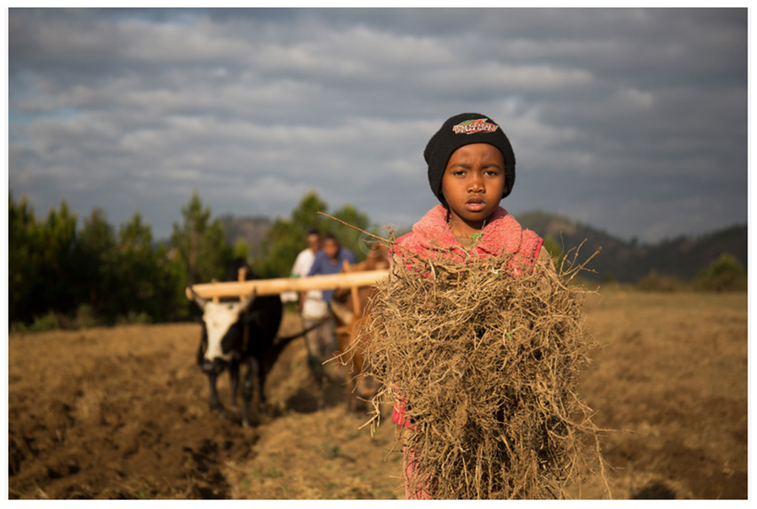
This is Nirinasoa
Notes:
This is Nirinasoa. She is 8 years old and lives in a village in Madagascar, an island off the east coast of Africa. Here she is helping on her family’s farm.

Slide 3
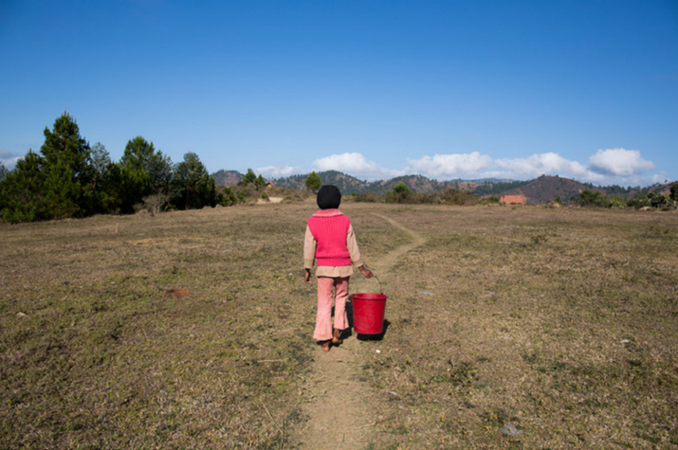
Notes:
Nirinasoa doesn’t have clean running water in her home. Instead she has to go on a long walk to collect it in a bucket.

Slide 4
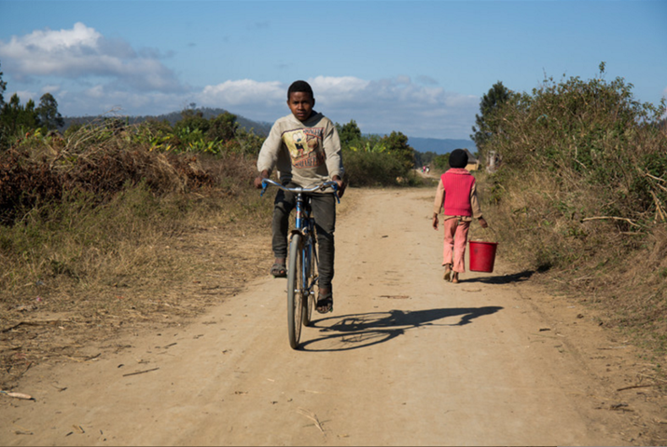
Notes:
She walks along a dusty road…

Slide 5
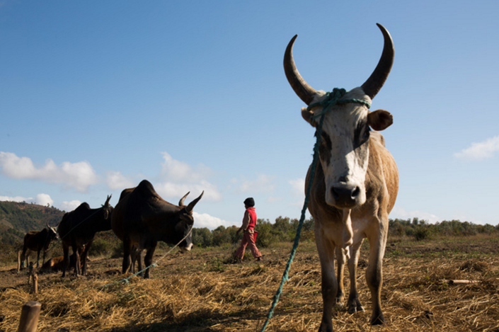
Notes:
Through a field of cattle…

Slide 6
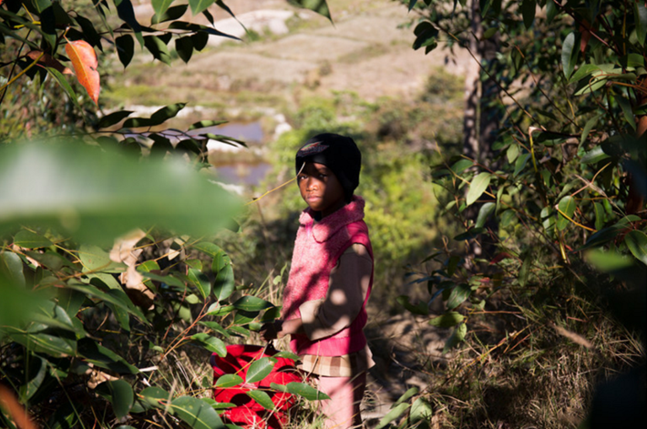
Notes:
Through wooded areas…

Slide 7
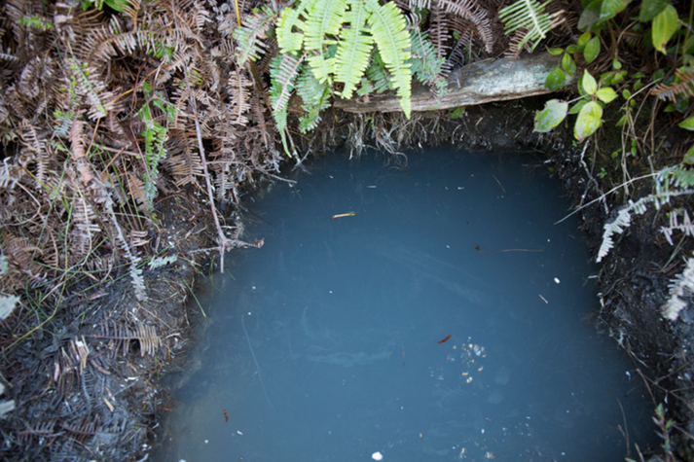
Notes:
Until she finally reaches the water. How would you feel if this was the water you had to drink?

Slide 8
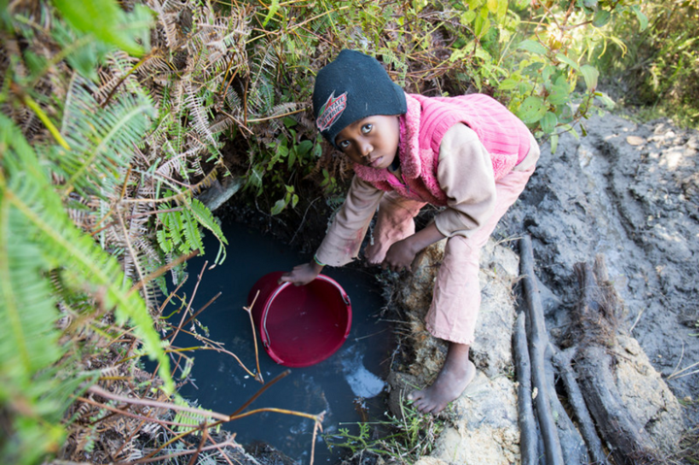
Notes:
Nirinasoa fills up her bucket with dirty water.

Slide 9
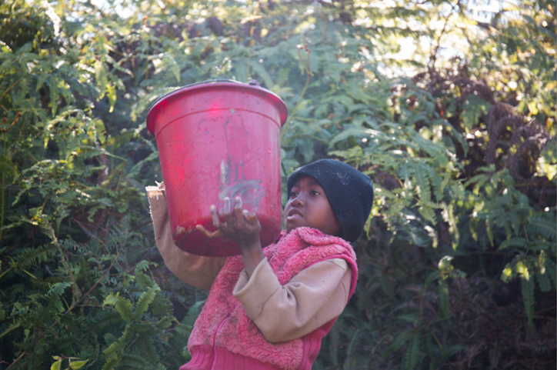
Notes:
The bucket is very heavy.

Slide 10
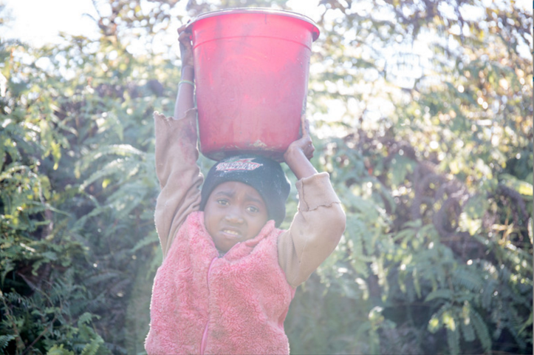
Notes:
Nirinasoa struggles to lift it onto her head. How do you think it would feel to carry a bucket like this?

Slide 11
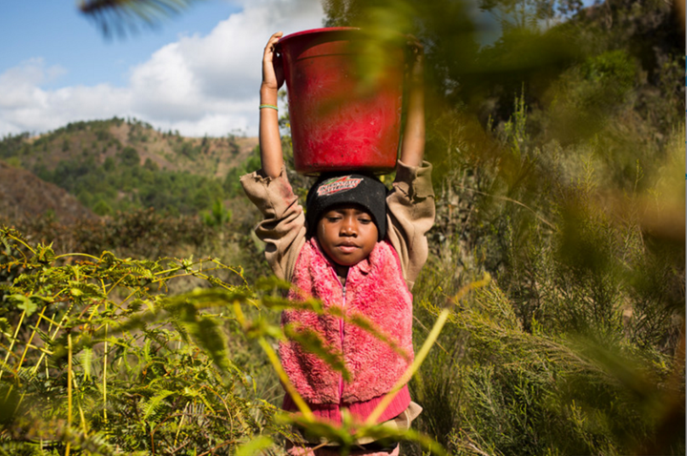
Notes:
She carries the heavy bucket back through the woods…

Slide 12
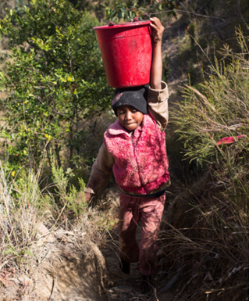
Notes:
Up a steep hill…

Slide 13
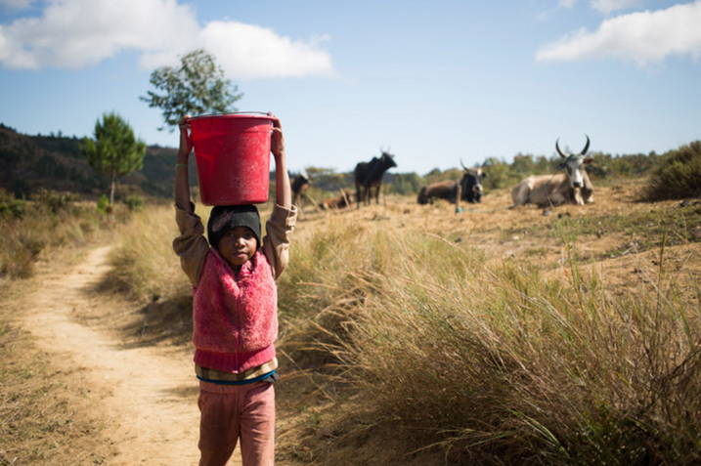
Notes:
Through the cattle field…

Slide 14
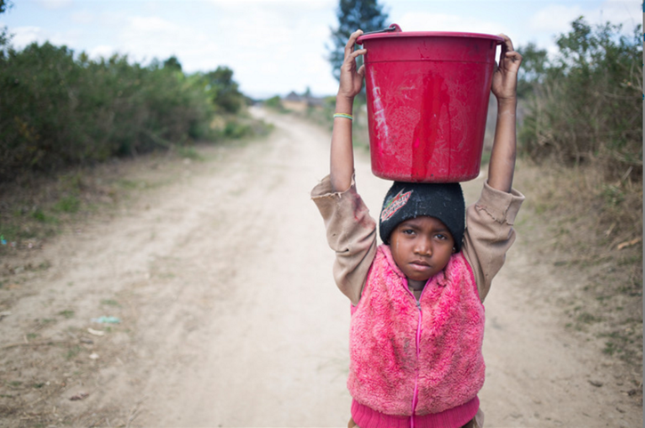
Notes:
Along the dusty road…

Slide 15
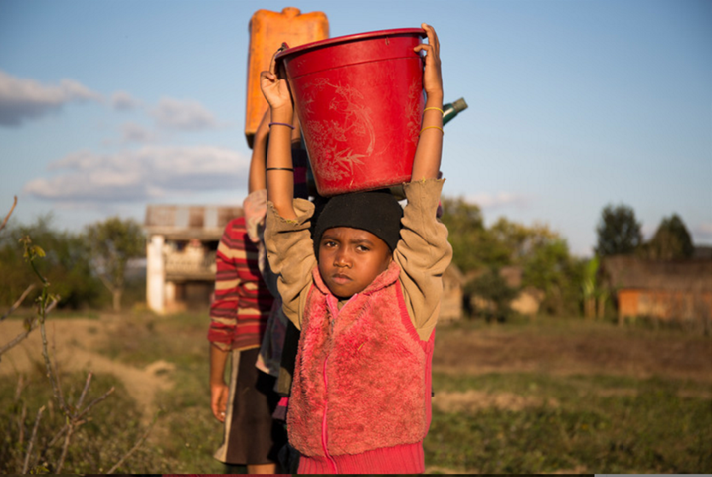
Notes:
And back home to her village.

Slide 16
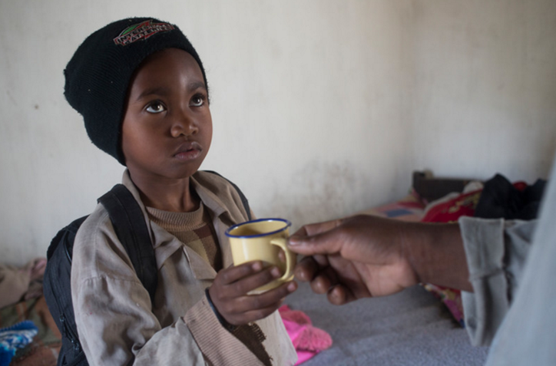
Notes:
Nirinasoa drinks a cup of the dirty water. How could this harm her?

Slide 17
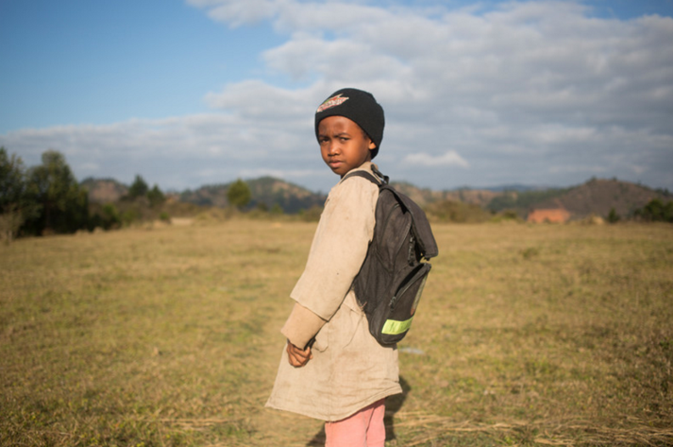
Notes:
And then she heads out again to walk to school. She will walk to get water twice more during the day.

Slide 18
What do you think about…
How far Nirinasoa has to walk to get water?
Where she has to walk?
What the water is like?
Nirinasoa doing this before she even goes to school?
And…
If there is so little water for drinking, what happens when she needs the toilet?
Notes:
Ask the pupils these questions to prompt a discussion.

Slide 19
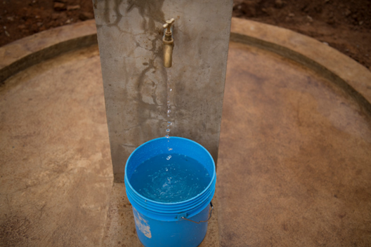
Good news!
Next year, WaterAid will be helping Nirinasoa’s village to get clean water points like this:
Notes:
Ask the pupils what difference this will make to Nirinasoa’s life.

Slide 20
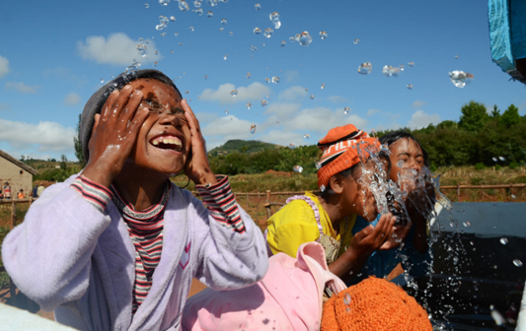
Nirinasoa will be as happy as these other children in Madagascar.
Notes:
This Madagascan village already has clean water. Soon, Nirinasoa’s will have it too.

Slide 21
What can we do as a class to help other children like Nirinasoa?
Notes:
Ask pupils what they could do to raise money for WaterAid so it can continue helping people like Nirinasoa.

