Slide 1
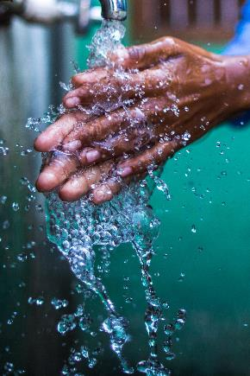
Global Handwashing Day
WaterAid/ Anna Kari
WaterAid/ Prashanth Vishwanathan
WaterAid/ Anil Cherukupalli
Notes:
Use this presentation to give showcase WaterAid’s work, the importance of handwashing and introduce Global Handwashing Day. Suitable for Key Stages 2 and 3.
Start by asking if anyone has heard of WaterAid before and ask what WaterAid do. Reiterate that WaterAid provide clean water, decent toilets and hygiene to some of the poorest communities around the world. Education around handwashing is a very important part of WaterAid’s work and this session is all about why handwashing is vital and even has its own special day.

Slide 2
Washing
hands
.
WaterAid/ Saiyna Bashir
Key words: Hand washing Disease Soap Hygiene
Water Germs Resources Bacteria Sanitation
Notes:
Give the class a minute or so to think about why we wash our hands.
The teacher should write list in a brainstorm format for the whole class to view using students input.
Follow on questions to ask: (answers an be added to brainstorm).
-When should we wash our hands? (before eating, after playing, touching animals going to the toilet, etc…)
-Why is it important to wash our hands at these times?
-What happens if we do not wash our hands?
-What recent events have highlighted the importance of handwashing for everyone?
-Ask students to think about the impact Covid 19 had on our hygiene. Ask if it has made them more aware of the importance of hygiene.
Lesson objective:Students to learn about the importance of washing their hands, through case studies from people around the world who do not have access to clean water and soap.
Student will learn how not having access to clean running water can affect a person's overall well-being.
Students will partake in activities that educate them on the importance of washing their hands.
Students will be made aware of Global handwashing day which takes place on the 15th October.

Slide 3
Notes:
WaterAid teaches people about good hygiene by explaining that things like washing your hands after going to the loo or before eating can make a really big difference to your health.
In fact, washing your hands with soap and water reduce the chances of getting diarrhoea by nearly half. Watch the film and ask students for their thoughts. Did anything surprise them? What did they find most interesting?
In groups, as the students to list the things contributing to good hygiene (possible answers below)
Knowing when to wash your hands (before eating, after playing, touching animals going to the toilet, etc…)
Keeping yourselves clean (bath and showers)
Safe food preparation
Washing up
They should feedback their answers and explain one of their points in more detail.

Slide 4
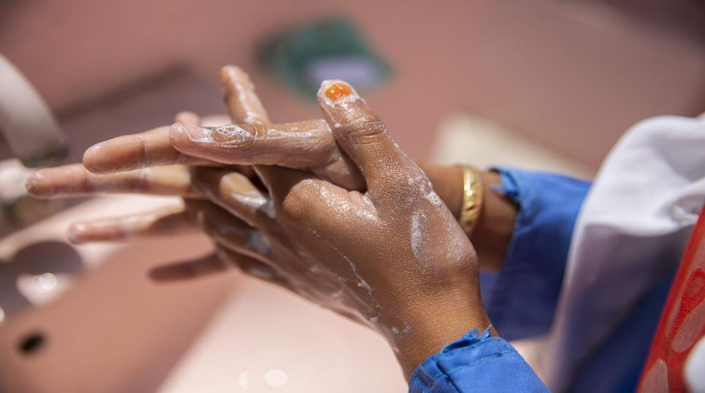
When did you last wash your hands?
1 in 10
People don’t have clean water close to home. That’s 785 million people
Handwashing with soap can reduce diarrhoeal diseases by 30%
WaterAid/ Saiyna Bashir
Notes:
Explain that in some low- and middle-income countries, many people do not have soap and water to wash their hands or clean with, and practising handwashing at key moments is not widespread. Ask the students when they last washed their hands and where? Do they have access to the facilities to wash? What would they do if they didn’t?

Slide 5
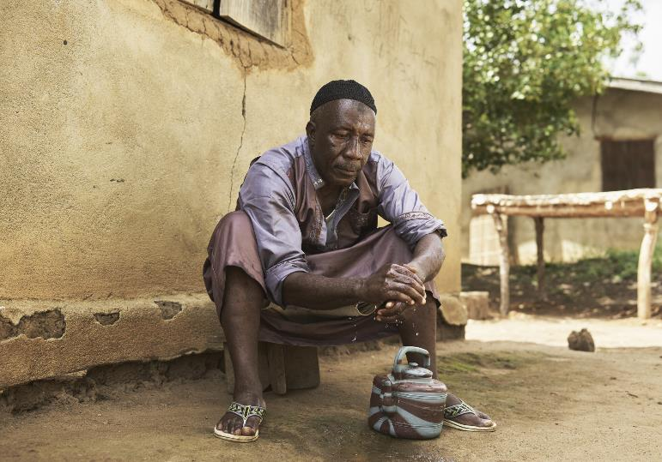
Ibrahim lives in a village in Sierra Leone. He had no choice but to wash his hands with dirty water as that was all that was available.
3 in 4 people
WaterAid/ Joey Lawrence
Notes:
In least-developed countries, nearly 3 in 4 people have nowhere at home to wash their hands with soap and water. This creates a higher risk of illnesses and diseases spreading.
Ibrahim’s community has no electricity, no phone signal, no school, no clinic, and no clean water.
Ask students how they think the lives people in Ibrahim’s village is different to their own? What challenges might they face? How might their health be affected?

Slide 6
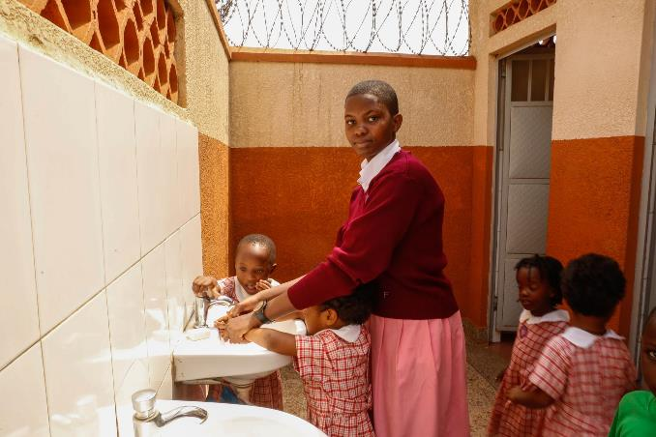
Mary is 17 years old and teaches other students from a younger class how to wash their hands, at a school in Uganda.
Mary, aged 17,
Uganda
WaterAid/ James Kiyimba
WaterAid/ Joey Lawrence
Notes:
Mary is 17 years old. She has access to clean water and toilets at home and at school.
Mary enrolled in the school before the new toilets were constructed, and she said that the smell from the old toilets was so bad that she would wait to use the toilet when she got home at the end of the day.
The primary school where Mary is helping younger students is one of the schools which have benefited from WaterAid’s support. The school has a new flushing toilets for both boys and girls. It also has a strong team of teachers supporting the promotion of sanitation and hygiene by setting up a school hygiene club, where learners are trained to become hygiene ambassadors both at school and at home.
Teacher to ask students to imagine having to avoid going to the toilet at school because of the smell and having no facilities to wash their hands. Ask how that would that make them feel? What would they do in this situation? Do they think hygiene clubs are a good idea? Why? Ask what they think an ambassador does and why hygiene ambassadors work both in school and at home in Mary’s community.
Explain that hygiene clubs and ambassadors are a great way of educating abut good hygiene and spreading awareness throughout communities.

Slide 7
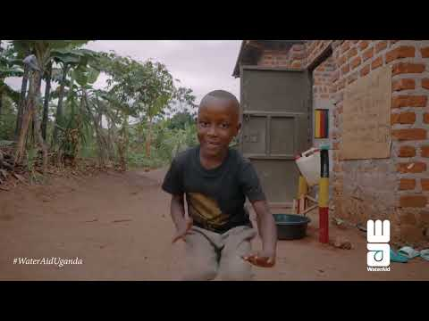
Clean hands are happy hands
Mary, aged 17,
Uganda
WaterAid Uganda featuring Masaka Kids
WaterAid/ Joey Lawrence
Notes:
Show film - clean hands are happy hands .
Songs and dances are often used to spread important hygiene messages. In the communities where WaterAid work. Ask the students whether they think this is an effective way to get people to remember the importance of handwashing and why?
As an extra activity, students could be tasked with coming up with a song, dance or poem to perform for others to remember the importance of handwashing.

Slide 8
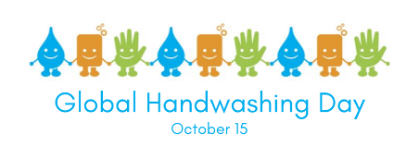
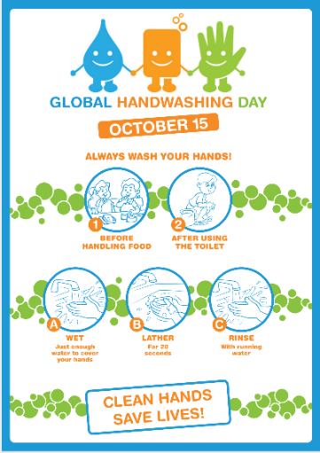
Global Handwashing Day is an annual day dedicated to promoting the importance of handwashing with soap as an easy, effective, and affordable way to prevent diseases and save lives.
Notes:
Introduce Global Handwashing Day.
Explain that October 15 is Global Handwashing Day, a global day dedicated to increasing awareness and understanding about the importance of handwashing with soap as an effective and affordable way to prevent diseases and save lives.
Ask students what they think about having a day dedicated to handwashing.

Slide 9
What can we do to support and celebrate Global Handwashing Day?
The 2022 Global Handwashing Day theme is “Unite for Universal Hand Hygiene.” This year’s theme calls on all of society to work together as we scale up hand hygiene and reminds us that we be united in our vision for universal access and practice of hand hygiene. No matter your role, you can celebrate Global Handwashing Day.
Notes:
Teacher to ask students :
What can we do to celebrate and support Global Handwashing Day and remind people of the importance of washing our hands ?
Brainstorm ideas and as a class choose a few to take forward in school to remind people about handwashing not just on Global Handwashing Day but throughout the whole year.

