Slide 1
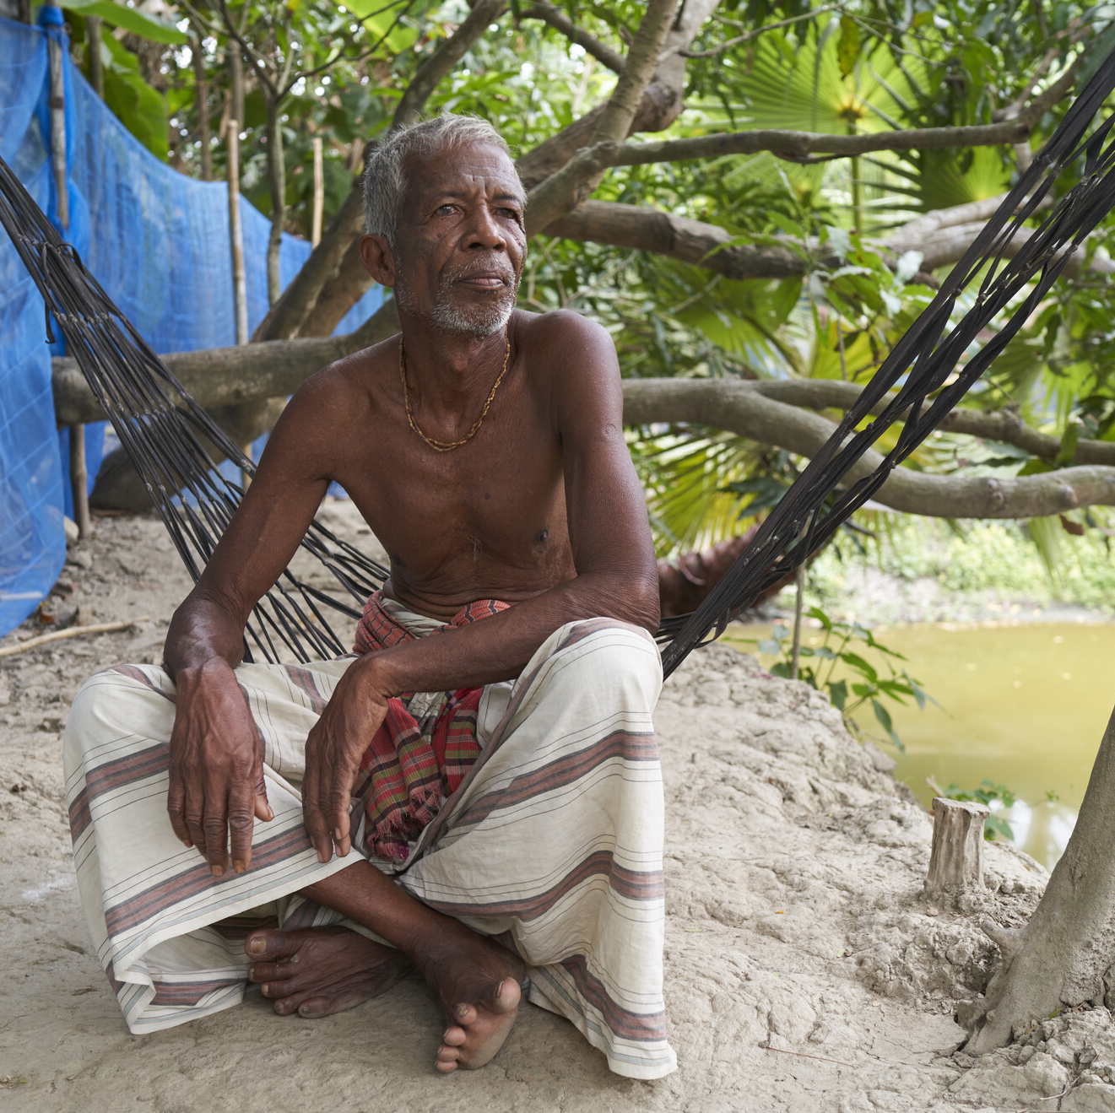

Water Means Life
WaterAid/ Fabeha Monir
Notes:
You can use this presentation to share WaterAid’s Christmas appeal with your group.
Set the scene…
Explain that Debendranath has worked hard labour in the mangrove forest all his life and witnessed plenty of change over the years. He’s seen everything he owns destroyed by a cyclone, twice.
The most important thing for Debendranath is providing for his family. He tried to build a toilet, but then his daughter became ill and needed an urgent operation to remove a tumour. He spent all his money on medical expenses and the toilet never got built. Despite the difficult life Dependranath has had, he still has hope for the future.
“I’m proud of the community, we have unity. If we get clean drinking water in our community, I believe it would be very good for us .”

Slide 2
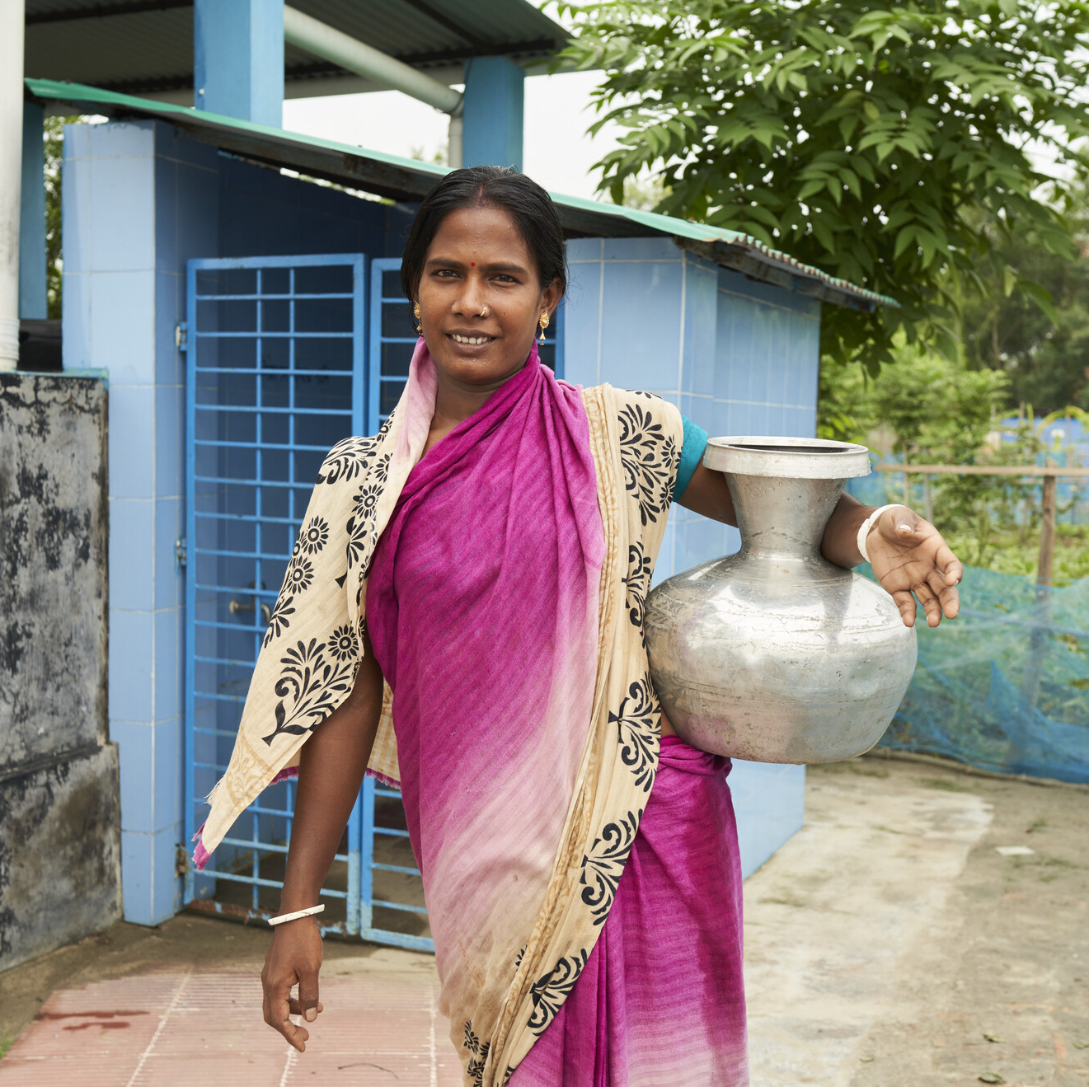
WaterAid/ Fabeha Monir
Notes:
Clean water will empower more women like Komola.
A respected member of the community, Komola was given the job of taking care of the water harvesting plant in her community, which she enjoys. She also makes mats and looks after her daughter.
Before the water plant, Komola would have to make long journeys to a pond to collect water which wasn’t always clean. She often suffered from diarrhoea. With more time and better health, Komola now attends training sessions on women’s rights. She is determined to share her newfound knowledge with her community.
“I want to teach my community about equality and that there should be no discrimination.”

Slide 3
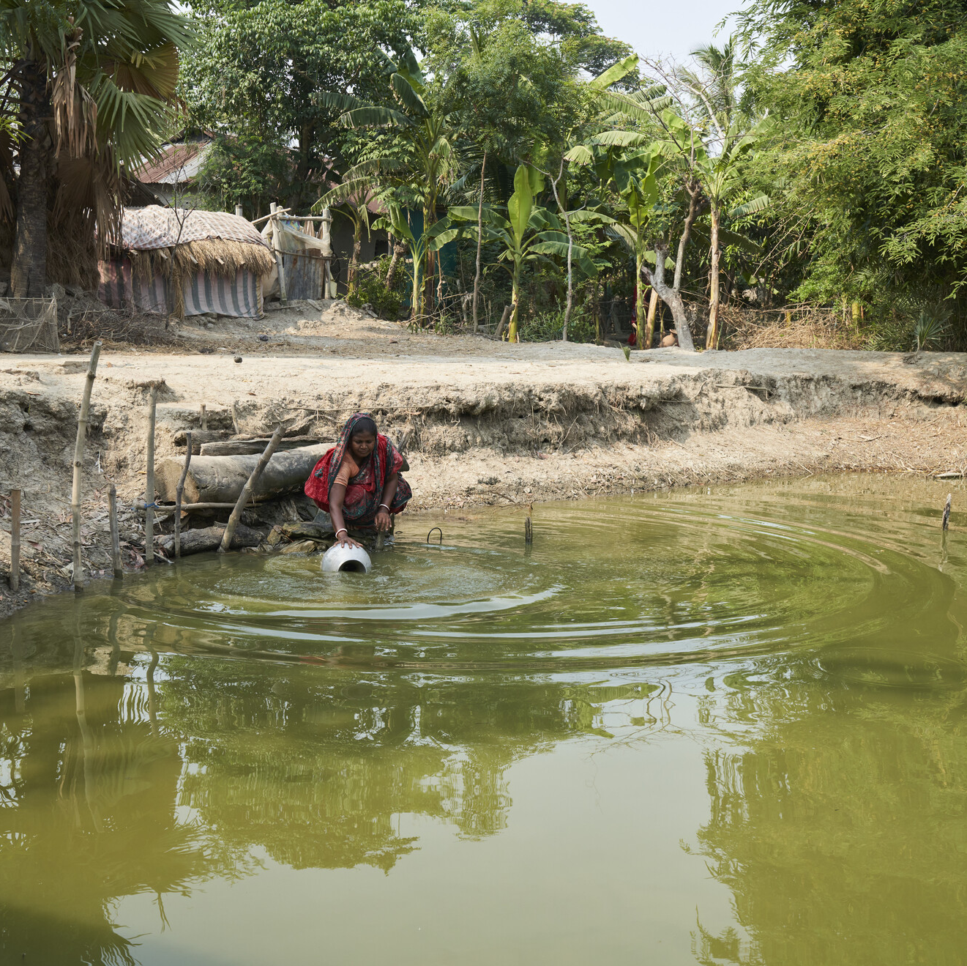

WaterAid/ Fabeha Monirl
Notes:
Clean water will help the Munda community to survive – and thrive.
Today, Bangladesh is the seventh most climate-change-affected country in the world. Situated on low-lying flood plains and tidal plains, it has one of the most disaster-prone deltas on earth. But for a country that sees so much water (there are 24,000kms of river) much of it is undrinkable.
In the north the rivers are contaminated with arsenic and in the south, where Bhetkali is, the rivers are too salty due to saltwater intrusion. Bangladesh is prone to cyclones, floods and periods of drought.

Slide 4
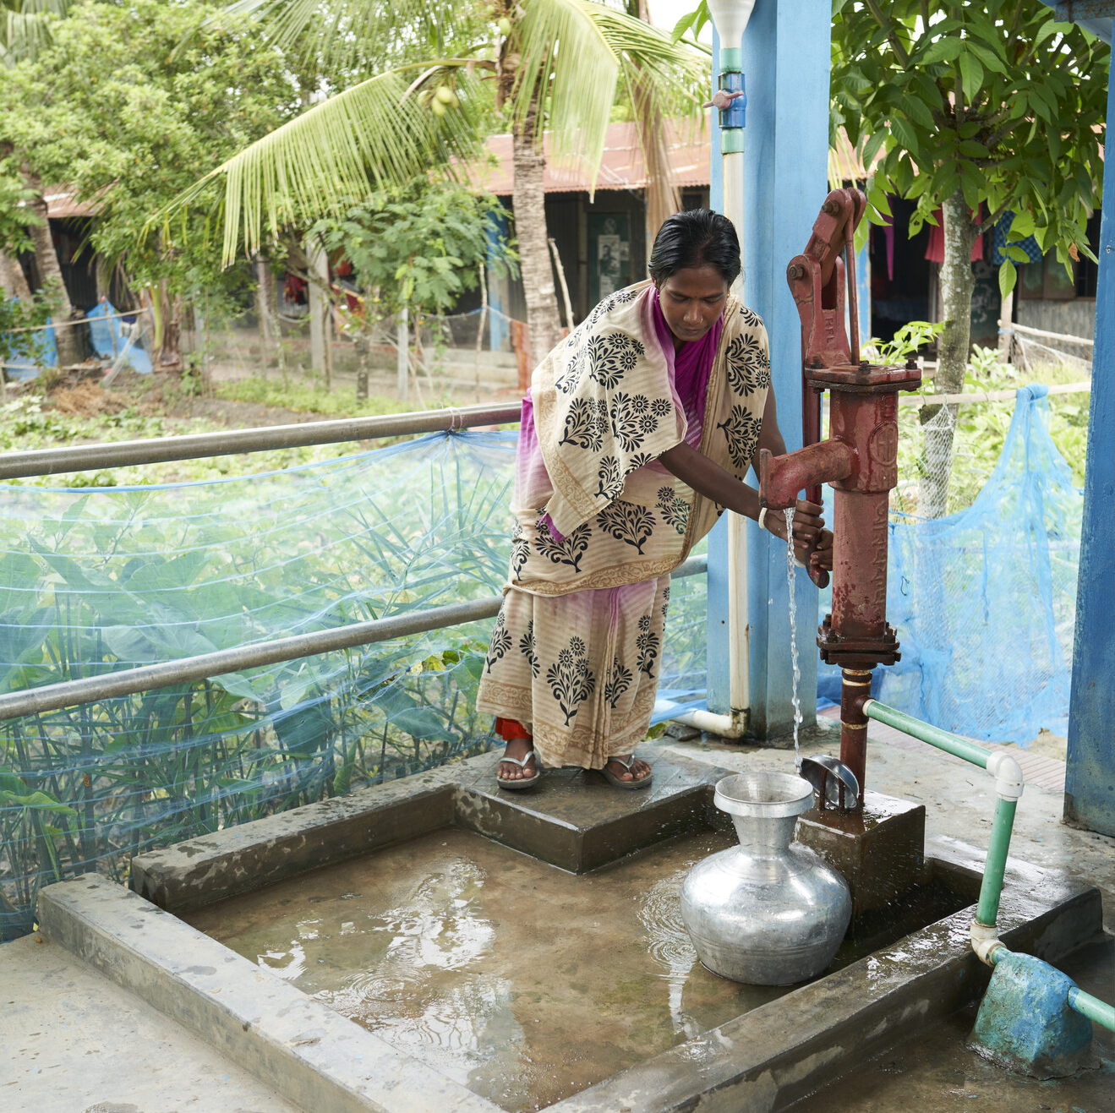

WaterAid/ Fabeha Monir
Notes:
The solution: A water harvesting system.
In Bhetkhali, we plan to work with partners and communities to install a rainwater harvesting plant that provides clean drinking water, toilets, private bathing facilities for women, and income-generating wormeries for food waste. We’ll also run hygiene awareness programmes.
Advantages of rainwater harvesting
Low maintenance
Easy to install
Rainwater can be used without treatment (providing a clean surface has been used)
Provides a source of clean water close to homes, schools and clinics

Slide 5
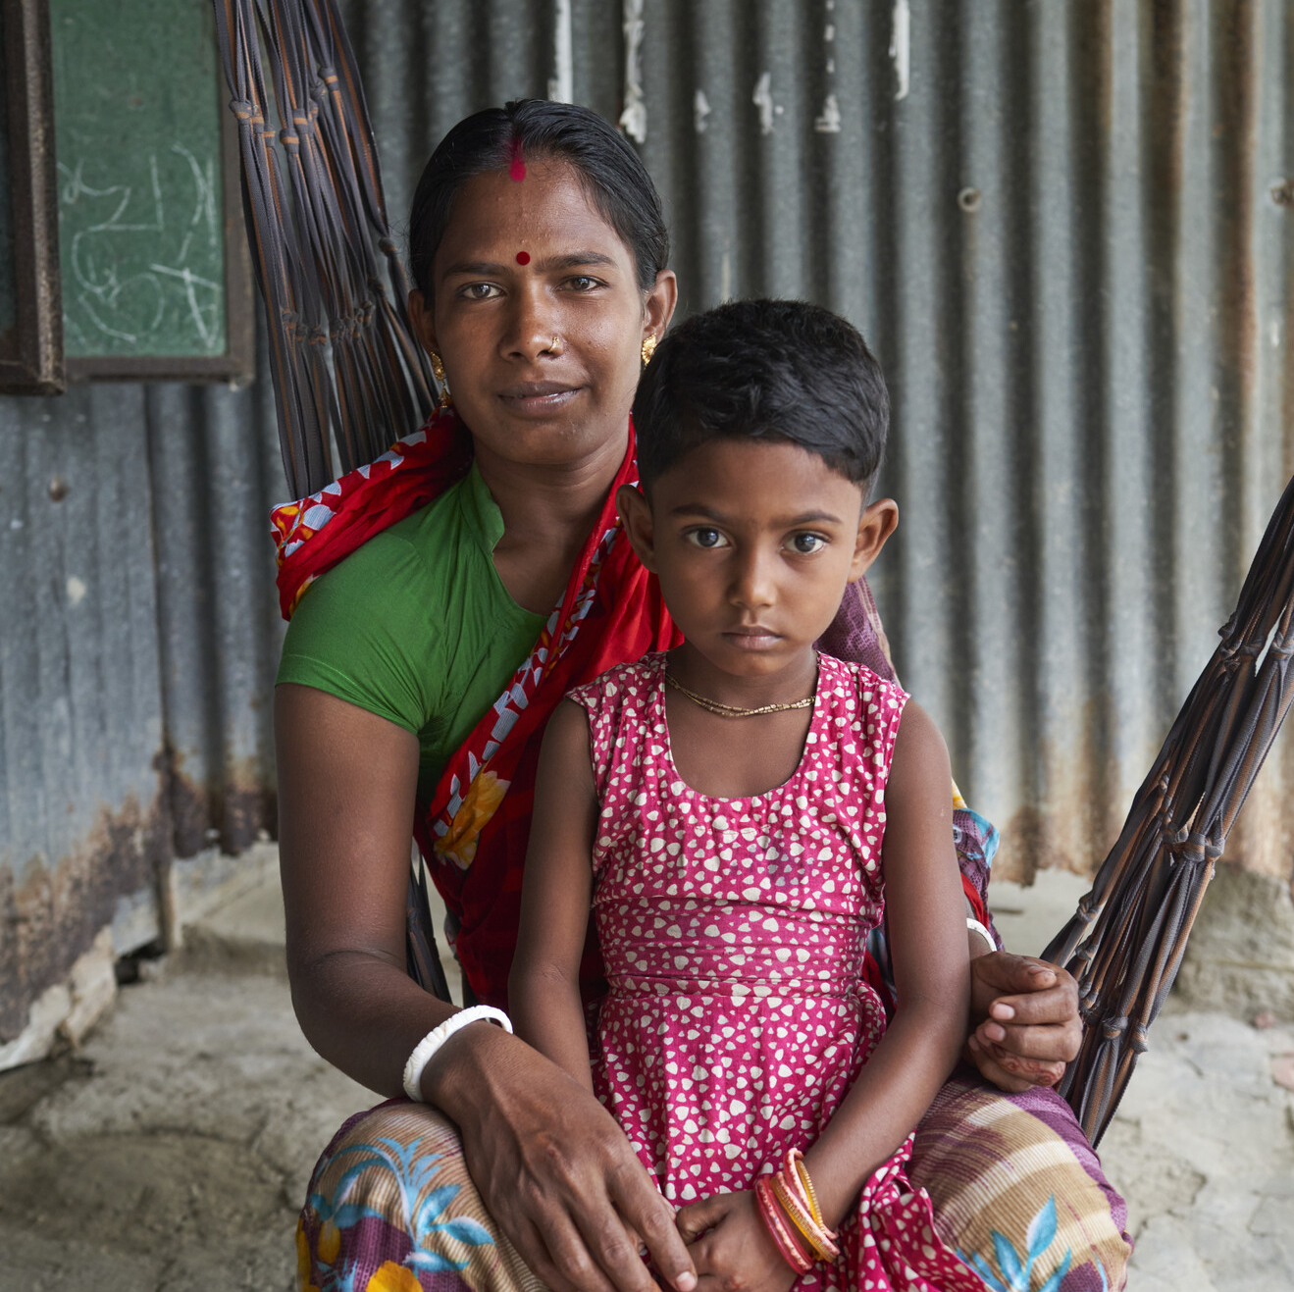
WaterAid/ Fabeha Monirl
Notes:
Explain that this Christmas, your group is fundraising for WaterAid. You’ll help bring clean water to communities in Bangladesh.

