Slide 1
Menstrual Hygiene Management Day 28th May
WaterAid/ Ernest Randriarimalala
#PeriodProud
Notes:
Slides are kept simple with notes to guide you in your assembly.
Believe it or not, there is a whole day dedicated to periods that takes place every year on the 28th May. It’s called Menstrual Hygiene Management Day. Menstrual Hygiene Management is a fancy way of describing what is needed to manage when you are on your period.
It may sound like a strange idea to have a day completely dedicated to periods, but with so many women and girls’ lives affected by something as natural and normal as a period, it’s important to highlight the changes that need to take place and work that is already going on to make things happen.
Most importantly we need to feel comfortable talking about it, so that something can be done.
Menstrual Hygiene Management Day raises awareness about the fact that once women and girls have what they need to manage their period – a decent toilet, clean water and good hygiene – they can start to fulfil their dreams and lift themselves out of poverty.
Why is Menstrual Hygiene Day on 28 May? Because May is the fifth month of the year and periods often last for 5 days a month, and a menstrual cycle (the amount of time between periods) is around 28 days.

Slide 2
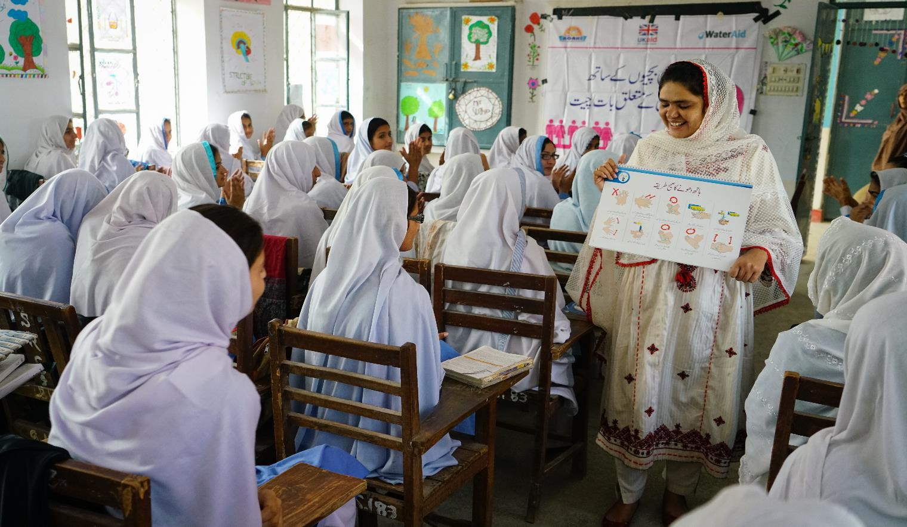
Let’s talk about periods
WaterAid/Eliza Powell
Notes:
Getting your period.
It’s one of the most normal things in the world for billions of women and girls.
What shouldn’t be normal is having to manage your period without clean water, a decent toilet or good hygiene. Yet that’s what millions of girls and women are forced to do every single month. And the price they’re paying couldn’t be greater.
WaterAid believe that every woman and girl should be able to manage their period in a hygienic way, with privacy, safety and dignity.
Every day, 800 million women have their period, yet in most parts of the world it is considered embarrassing and taboo.
Who here is happy to talk openly to anyone about periods? (Ask for a show of hands)
It’s not an easy subject, as it’s been seen as very private or as a taboo, which means it is something that people won’t talk openly about. This secrecy makes it much more difficult for women and girls to get help and support to manage their periods hygienically and with dignity.
One in three women around the worlds who have no access to a decent toilet.
3 in 10 schools worldwide don't have clean water and 1 in 3 don't have toilets. This means that when students are on their period, they often stay at home and miss out on their education.
Can you imagine having to miss out on your education, and your opportunity to achieve your dreams because you are on your period?
WaterAid is working to ensure that all girls have access to the decent toilets, clean water, information and support needed to manage their periods with dignity, so they can stay in school and achieve their dreams and aspirations. When a community gets clean water, decent toilets and good hygiene, it’s girls and women whose lives can change the most.

Slide 3
.
billion people do not have a decent toilet of their own
Almost
1 in 3
people
Notes:
So how big is the problem around the world?
2.3 billion people worldwide – almost 1 in 3 – do not have a decent toilet of their own.
Imagine managing your period each month without access to a toilet?

Slide 4
What is needed to manage periods hygienically?
Notes:
Can you think of what girls and women need to ensure that they can manage their period? (ask for suggestions or give answers)
To manage periods hygienically, it is essential that women and girls have:
Access to affordable period products such as sanitary cloths or pads.
A safe, private toilet with a lock, where they can change sanitary cloths or pads. Additionally, there should be facilities for safely disposing of used sanitary cloths or pads, or a place to clean and dry them if reusable.
Clean water available for good hygiene.
Soap for handwashing and washing used sanitary cloths or pads.
Education - information, advice and support about periods is vital.
Without these things, girls often avoid school when on their periods, and many drop out entirely.

Slide 5
1 in 10 girls in Africa miss class on their period and go on to drop out of school.
Only 23% of girls in Niger have a private place to change sanitary towels at school.
More than 1 in 5 girls in India will drop out of school when they reach puberty.
Notes:
What do these statistics tell us about the link between periods and girls achieving their potential?

Slide 6
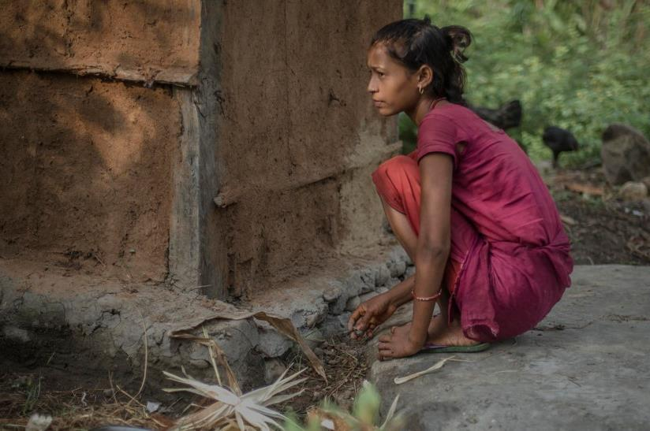
When your period means you can’t go home
WaterAid/Poulomi Basu
Notes:
There are many myths and taboos all over the world about periods.
Some people believe that you shouldn’t play sport when you’re on your period, or shouldn’t take baths or wear trousers.
These are not true, but because periods are not something that we talk about openly, it means that a lot of incorrect information gets passed from person to person which can stop women and girls’ from living their normal everyday life during their period and can even be harmful to their health.
Restrictions on what women and girls can do when they’re on their period occur in many countries all over the world.
This is Radha. She lives in a small village in Nepal. When she has her period, she’s not allowed inside her house and can only eat boiled rice, thrown to her by her sister, who she mustn’t touch. This belief is held by those in her community and it has been passed down through generations.
For more information visit: https://www.wateraid.org/uk/stories/when-your-period-means-you-have-to-live-in-a-shed

Slide 7
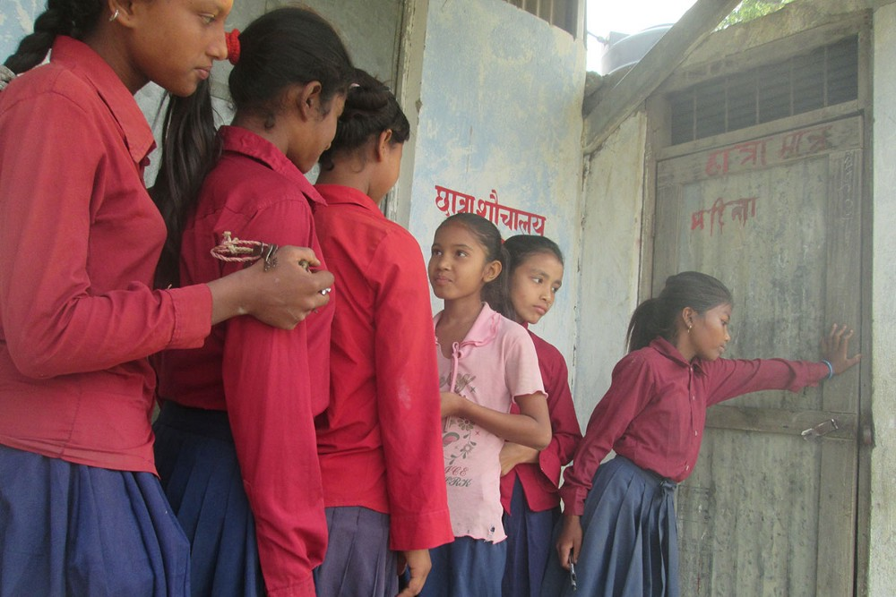
WaterAid/Sushma Diyali
Notes:
“This is the girls toilet at our school. It doesn’t lock properly. If someone is inside, someone else has to wait outside, pushing the door. Because of the lack of toilets we have to wait in a long line. This is why we need more girl-friendly toilets.” – Sushma, 15, Nepal
15-year-old Sushma and her friends use the school toilets when they’re on their periods. As you can see there is a lack of privacy and long queues, as well as the facilities to safely dispose of or wash period products which can make girls and women feel anxious.
In addition to these problems, many girls and women also face the following issues:
Many girls don’t want to raise their hands in class in class for fear they will be asked to stand up and draw attention to any leaks from their period products.
Girls can be fearful of wearing white/ or light coloured clothing/school uniforms.
Girls and women are unlikely to have pain relief readily available at school, work or home.
There is unlikely to be a space for them to lie down if they are having period cramps/pains or a welcoming environment for them to talk about this.
Women and girls may have to undertake long journeys, with no access to a toilet or period products.
Girls might feel embarrassed, confused, scared and isolated, especially when getting their first period.
There is limited information available around periods. It may not be taught at schools or discussed at home. Girls may rely on word of mouth from friends, which may lead to fear and shame with no awareness of how to manage their period.

Slide 8
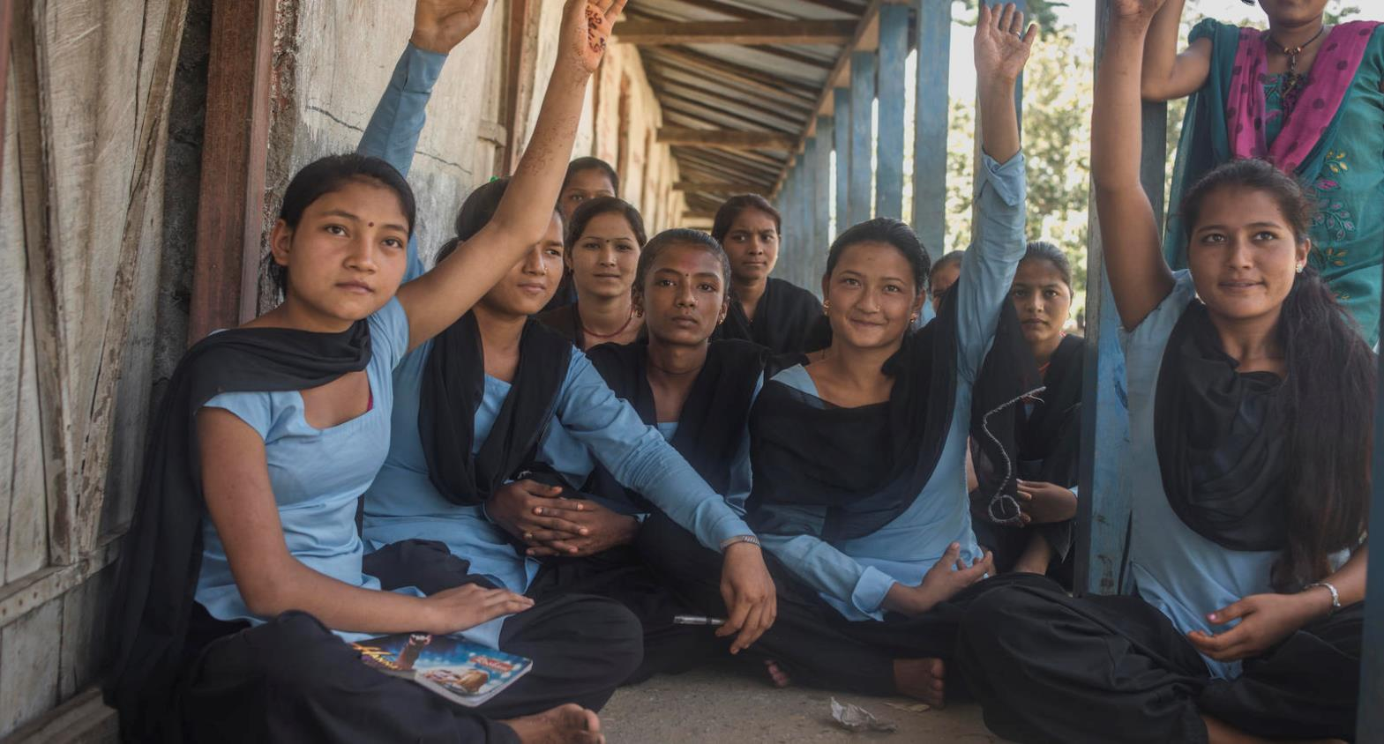
WaterAid/Poulomi Basu
Notes:
In this photograph, girls are discussing periods in a village in Nepal. With WaterAid’s help, they have got involved in making decisions about what they need when they are on their periods.
Today they are creating change, using what they’ve learnt to keep girls and women safe and enable them to continue their education without letting their periods hold them back.

Slide 9
Local materials and low-cost solutions
WaterAid / JordiChileshe Chanda
Notes:
“Most of the girls are poor, so we came up with the initiative of making reusable sanitary pads.“ Alice Namonje, Menstrual Hygiene Coordinator, Lubunda Primary School, Zambia.
This school now has clean water, decent toilets (with built in wash rooms) and sewing machines, so students can make reusable sanitary pads.
Alice said proper hygiene facilities played a big role in addressing the problems that came with periods.
“Many girls have ended up stopping school because sometimes they feel stigmatised during that period of the month,” said Alice. She explained that due to lack of proper toilet and hygiene facilities, girls were being forced to leave school when they began their periods. “Absenteeism was high among girls, some could stay away from school until after a week when they finish their periods,” said Alice. Along with improved facilities, Alice conducts weekly meetings with girls aimed at preparing them for the challenges that come with period. The girls’ club has over 300 pupils enrolled, where pupils form a strong support group and can share their experiences and strengthen one another.
“Girls should not stay home when they’re on their period, we are breaking the silence because periods are natural,” says Alice. The girl’s club received sewing machines from WaterAid, and they have been making reusable sanitary pads. “We came up with the initiative of making reusable sanitary pads because most of the girls are poor, they can’t afford to buy disposable ones month by month,” said Alice.

Slide 10
What is WaterAid doing? - Provide the right facilities such as decent, private toilets. - Provide the right information by encouraging people to speak openly about periods - Provide access to products that are affordable and sustainable and inform about how to dispose of used products safely
How can our school support students during their menstrual period?
Notes:
This slide provides a space for you to be able to discuss what is provided by your school currently or to request suggestions on what is desired by the young people at your school.

Slide 11
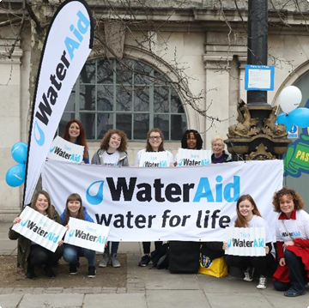
Get involved
WaterAid/Nick Webster
Get talking about
periods
Get fundraising
WaterAid/ Chris Ratcliffe
Notes:
By taking action in your school or community this Menstrual Hygiene Day you will be changing lives. For this year's Menstrual Hygiene Day, we want to build on the increasing discussion around periods and get people talking about them: the myths, the names, first period experiences and everything else that comes along with them. We want people to talk loud and proud about periods.
Get talking about periods! Join WaterAid's #PeriodProud campaign and help us end taboos around periods for good both here and abroad. Share our messages about periods and show everyone why you support Menstrual Hygiene Day. Download our posters and place them on toilet doors or in classrooms to raise awareness in your school community.
Get fundraising! Hold a collection in your school, or grab your apron and bake up a storm this Menstrual Hygiene Day. Ask us for some of our branded cake toppers to give your creations a WaterAid flourish. Or why not organise a sponsored walk to raise funds and draw attention to the fact that every day, billions of people still don't have access to a decent toilet.

Slide 12
Thank you
WaterAid/Kate Holt
Notes:
We’re determined to change normal for girls and women when they have their period, for good. That’s why, with your school's help, we’re able to keep working with our partners around the world to ensure communities have the clean water, decent toilets and good hygiene they need to safeguard their health and their dignity. It starts with these essentials. But it leads to girls being able to stay healthy and stay in school, giving them the chance to finish their education, get a job and break the cycle of poverty their families may have been trapped in for generations.
Thank you so much for making a difference this Menstrual Hygiene Day.
Background notes on the image:
Julianna, 16, hangs up her cotton sanitary towels to dry after washing them, these are given to young girls and women in the community as part of a hygiene awareness project in Morondavo, Madagascar.
"I first got my period when I was 14. I remember I had a pain in my stomach and I cried and then I told my mother. My mother told me all women have it and it’s not serious and she told me to use fabric. Sometimes at school I find it hard to concentrate but we have separate boys and girls toilets so I can change in break times.“

Slide 13
Notes:
WaterAid is a charity determined to make clean water, decent toilets and good hygiene normal for everyone, everywhere within a generation. WaterAid works in some of the poorest communities around the world and knows that once people have access to these three simple things, the results are life changing!
Find out more ways that you and your school can get involved in our #PeriodProud campaign this Menstrual Hygiene Day. For more information on this topic (including films and additional resources) visit: https://washmatters.wateraid.org/publications/menstrual-hygiene-matters
Can you imagine what life would be like at school if there were no toilets available? What would girls do if they were on their period? What if there was no clean water? How could you stay healthy and hygienic without clean water to wash your hands after going to the toilet? It’s highly likely that you would end up not going to school, and after missing lots of days, you may even end up dropping out altogether.

