Slide 1
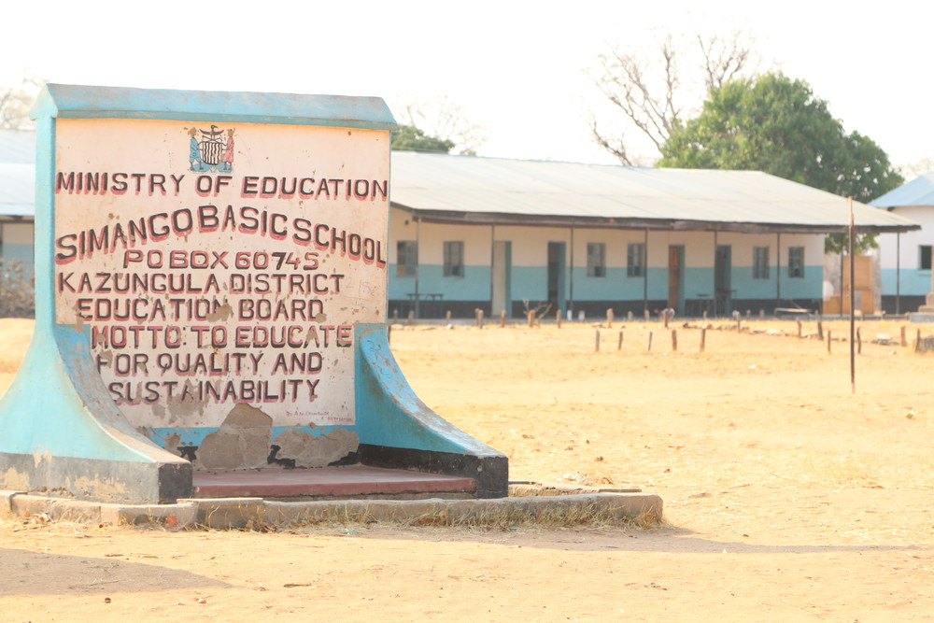
Notes:
Simango Basic School

Slide 2
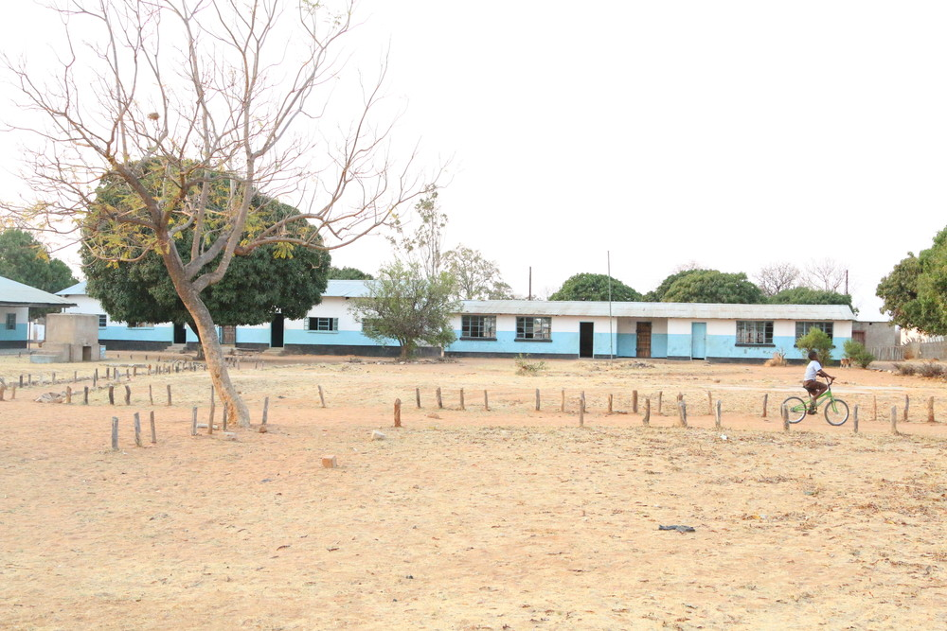
Notes:
Simango Basic School

Slide 3
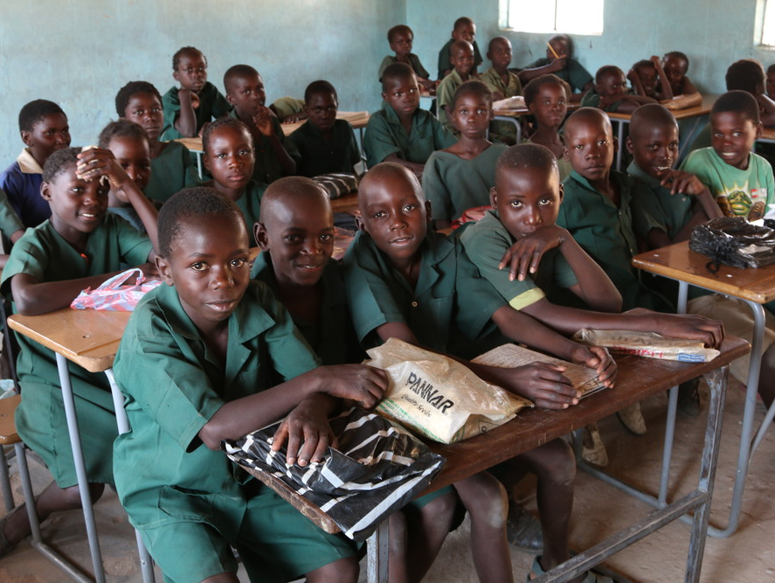
Notes:
Classroom in Simango Basic School

Slide 4
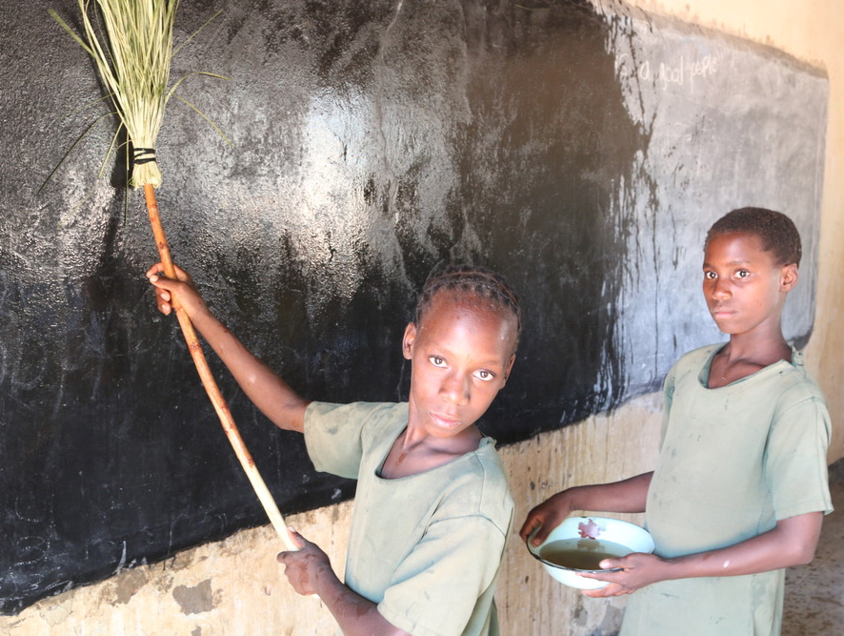
Notes:
Cleaning the blackboard

Slide 5
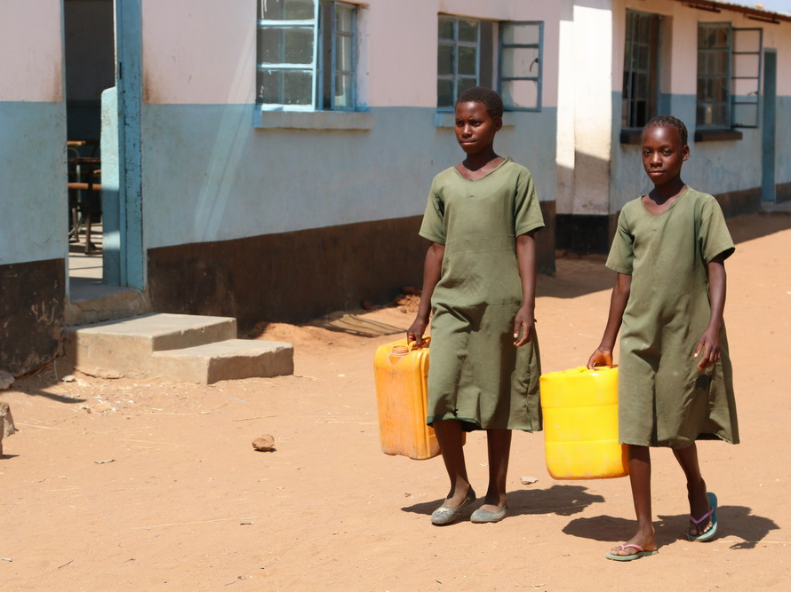
Notes:
Setting off to collect water

Slide 6
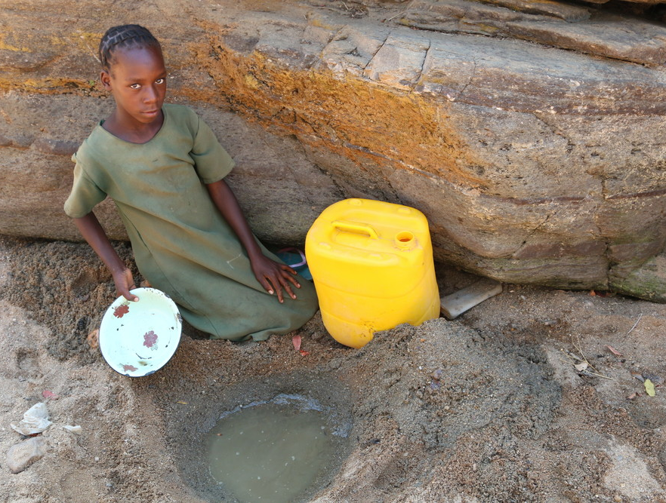
Notes:
Collecting dirty water from the river

Slide 7
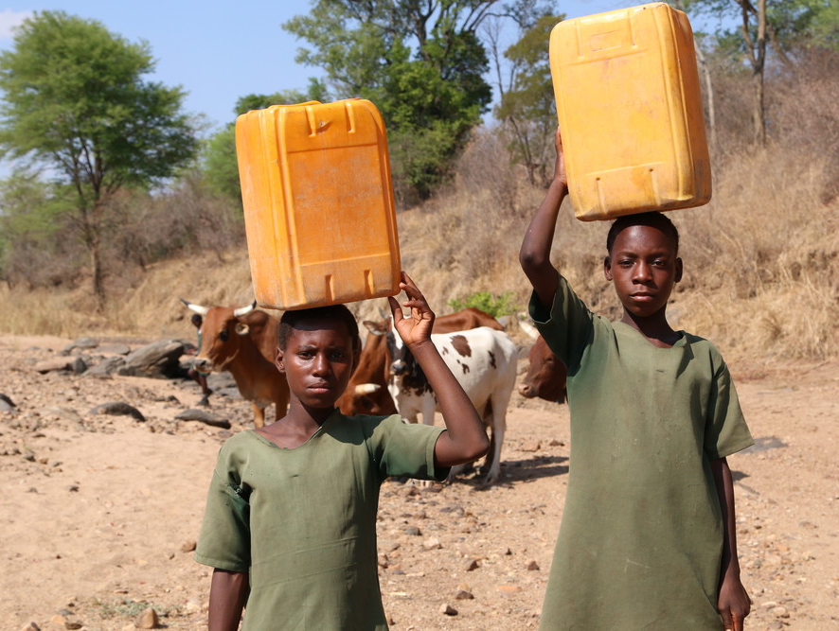
Notes:
The pupils at Simango school share their water source with animals such as cows

Slide 8
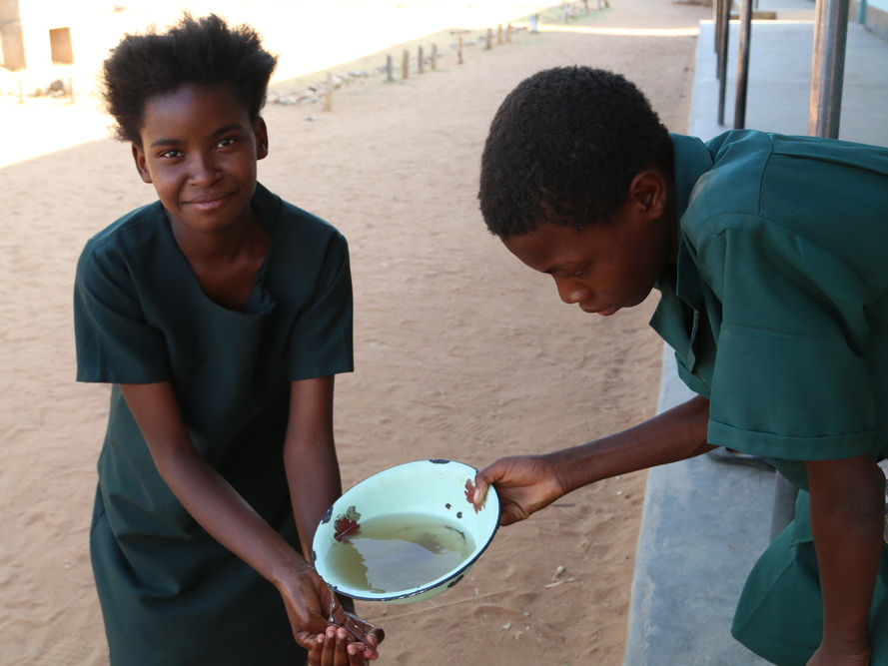
Notes:
Using dirty water to clean hands

