Slide 1
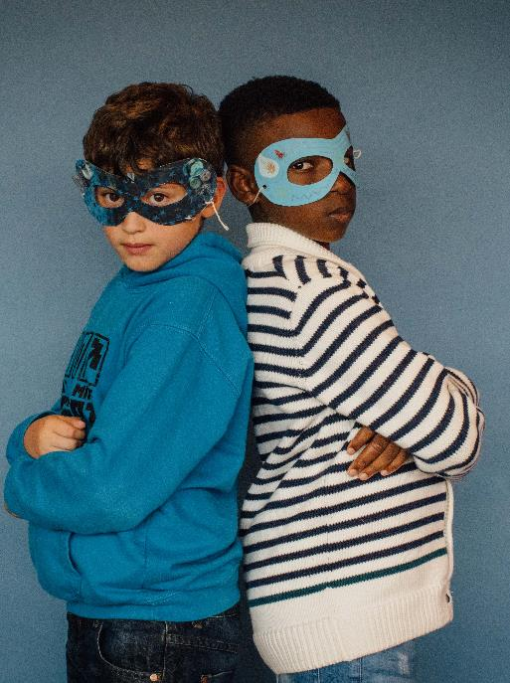
Water Warriors
WaterAid

Slide 2
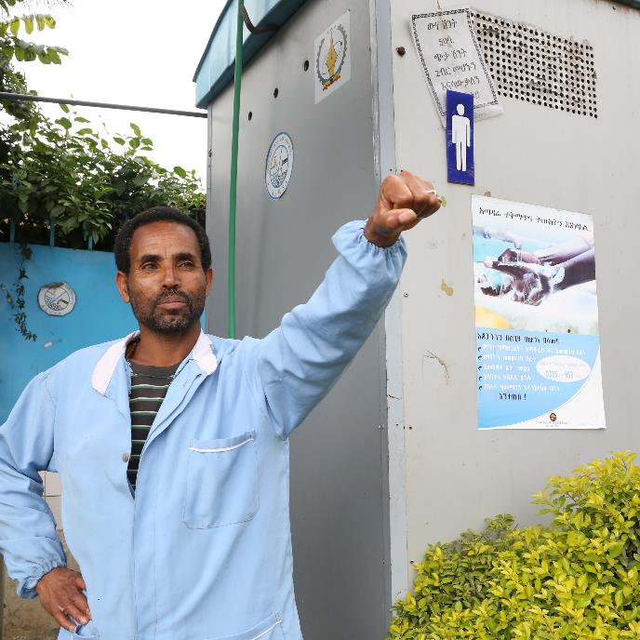

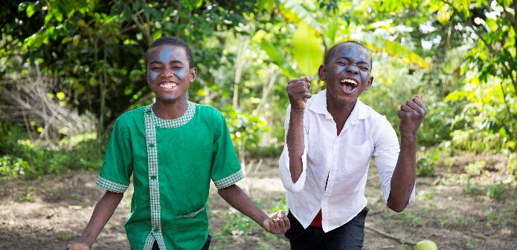
Let’s celebrate Water Warriors!
WaterAid/ Behailu Shiferaw
WaterAid/ Ernest Randriarimalala

Slide 3
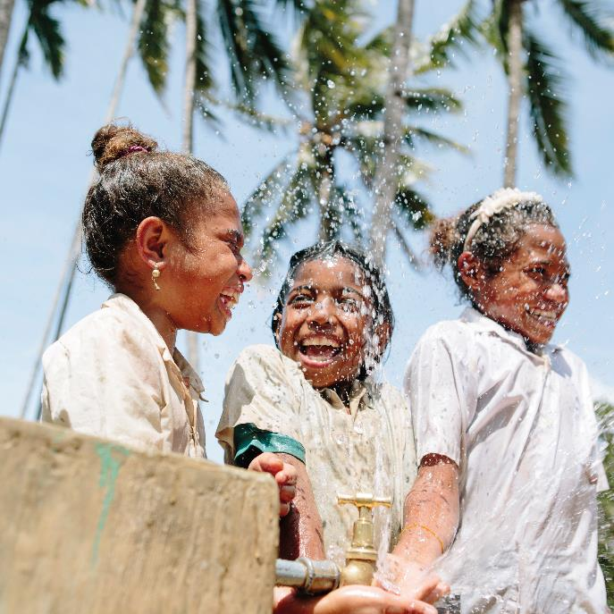
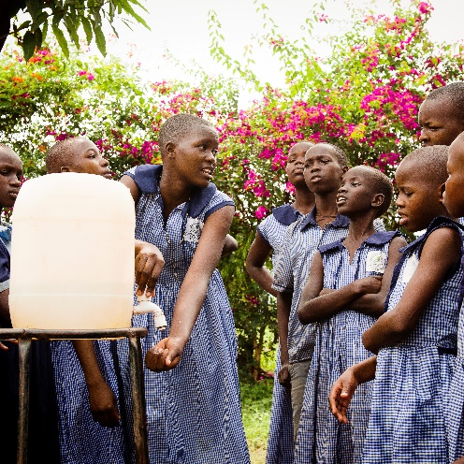



About WaterAid
WaterAid/ Eliza Powell
WaterAid/ Tom Greenwood

Slide 4
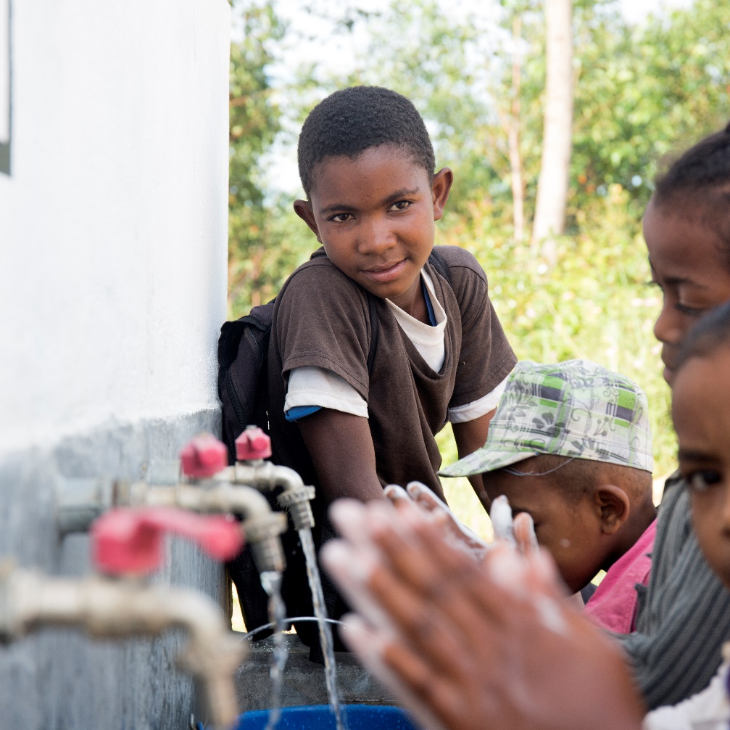

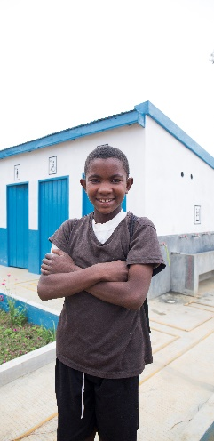

Tahiana, 13, from Madagascar
A real life Water Warrior
WaterAid/ Ernest Randriarimalala

Slide 5
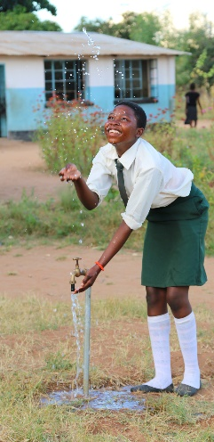
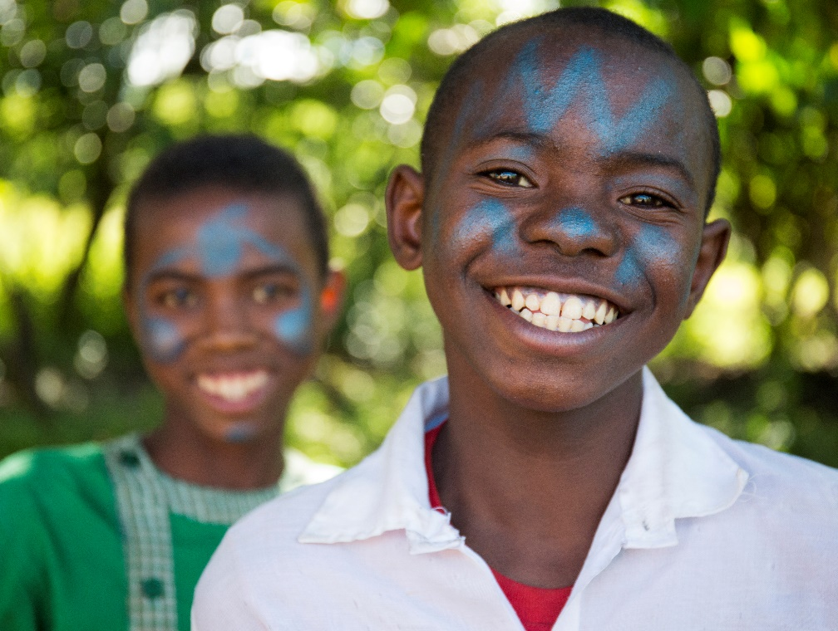


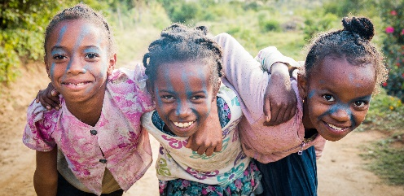
Together we will reach even more children with clean water!
WaterAid/ Chileshe Chanda
WaterAid/ Ernest Randriarimalala
WaterAid/ Ernest Randriamalala

